Slide 1
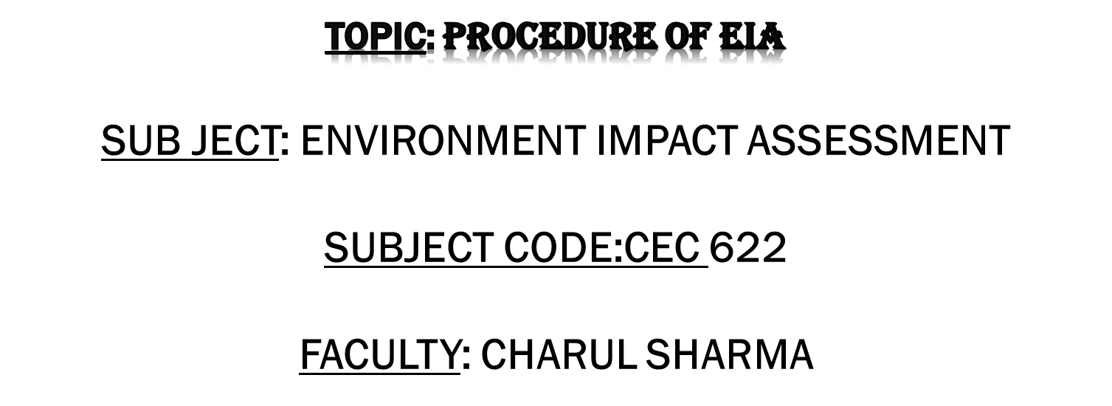

Slide 2
TOPIC OBJECTIVE
To familiarize students with the steps involved in EIA.
To familiarize students with the different procedures adopted for EIA.
To familiarize students with the different methodologies used in EIA.

Slide 3
ENVIRONMENTAL IMPACT ASSESSMENT
Environmental Impact process, involves evaluation of environmental implications and incorporation of necessary safeguards for those activities having a bearing on environmental quality. Evaluation of the beneficial and adverse effects of development project on the ecosystem is attempted, both qualitatively as well as quantitatively.

Slide 4
STEPS IN EIA
Screening
Scoping
Base line data collection
Identification of Impacts
Prediction and Mitigation Measures
Evaluation of Impacts

Slide 5


THE ENVIRONMENTAL IMPACT ASSESSMENT NOTIFICATION 1994
Composition of expert committee
  Ecosystem management
  Air/water pollution control
  Water resource management
  Flora/fauna conservation and management
  Land use planning
  Social sciences / rehabilitation
  Ecology
  Environmental health
  NGO representatives
  Subject area specialist

Slide 6
THE ENVIRONMENTAL IMPACT ASSESSMENT NOTIFICATION 1994
Application form contents
  Name, address, location of the project, alternate sites examined
  Objectives of the project
  Land use patterns
  Climate and air quality
  Water balance
  Solid wastes

Slide 7
THE ENVIRONMENTAL IMPACT ASSESSMENT NOTIFICATION 1994
Application form contents
  Solid wastes
  Noise & vibrations
  Source & power requirement
  Peak labour demand
  Risk assessment report, disaster management plan
  EIA, EMP, Feasibility report
  Environment cell

Slide 8
THE ENVIRONMENTAL IMPACT ASSESSMENT NOTIFICATION 1994
Information with application form
  EIA/EMP - 20 copies
  Risk analysis report – 20 copies
  NOC from SPCB
  Commitment for water / electricity availability
  Summary of project report
  Filled in questionnaire
  Comprehensive rehabilitation plan, if required

Slide 9
THE ENVIRONMENTAL IMPACT ASSESSMENT NOTIFICATION 1994
LIST OF PROJECTS REQUIRING ENVIRONMENTAL CLEARANCE FROM THE CENTRAL GOVERNMENT
  Nuclear Power and related projects such as heavy water plants, nuclear fuel complex, rare earths.
  River Valley projects including hydel power, major irrigation and their combination including flood control.
  Ports, Harbours, Airports (except minor ports and harbours).
  Petroleum Refineries including crude and product pipelines.
  Chemical Fertilizers (Nitrogenous and Phosphatic other than single superphosphate)
  Pesticides (Technical )
  Petrochemical complexes (Both Olefinic and Aromatic) and Petro-chemical intermediates such as DMT, Caprolactam, LAB etc. and production of basic plastics such as LDPE, HDPE, PP, PVC.

Slide 10
THE ENVIRONMENTAL IMPACT ASSESSMENT NOTIFICATION 1994
LIST OF PROJECTS REQUIRING ENVIRONMENTAL CLEARANCE FROM THE CENTRAL GOVERNMENT
Bulk drugs and pharmaceuticals
Exploration for oil and gas and their production, transportation and storage.
Synthetic Rubber
Asbestos and Asbestos products
Hydrocyanic acid and its derivatives.
Primary metallurgical industries (such as production of Iron and Steel, Aluminium, Copper, Zinc, Lead and Ferro Alloys).

Slide 11
THE ENVIRONMENTAL IMPACT ASSESSMENT NOTIFICATION 1994
LIST OF PROJECTS REQUIRING ENVIRONMENTAL CLEARANCE FROM THE CENTRAL GOVERNMENT
Integrated paint complex including manufacture of resins and basic raw materials required in the manufacture of paints.
Viscose Staple fibre and filament yarn.
Storage batteries integrated with manufacture of oxides of lead and lead antimony alloy
All tourism projects between 200 - 500 meters of High Tide Line or at locations with an elevation of more than 1000 meters with investment of more than Rs.5Crores.
Thermal Power plants.
Mining projects (major minerals) with leases more than 5 hectares.

Slide 12
THE ENVIRONMENTAL IMPACT ASSESSMENT NOTIFICATION 1994
LIST OF PROJECTS REQUIRING ENVIRONMENTAL CLEARANCE FROM THE CENTRAL GOVERNMENT
Highway Projects
Tarred Roads in Himalayas and/or Forest areas
Distilleries
Raw Skins and Hides.
Pulp, paper and newsprint
Dyes
Cement
Foundries (individual)
Electroplating
Meta Amino Phenol

Slide 13
EIA METHODOLOGIES
Adhoc Technique
Check list Technique
Matrix Technique
Network Technique
Overlay Technique
Mathematical Model Technique
Battelle Environmental Evaluation System (BEES)

Slide 14

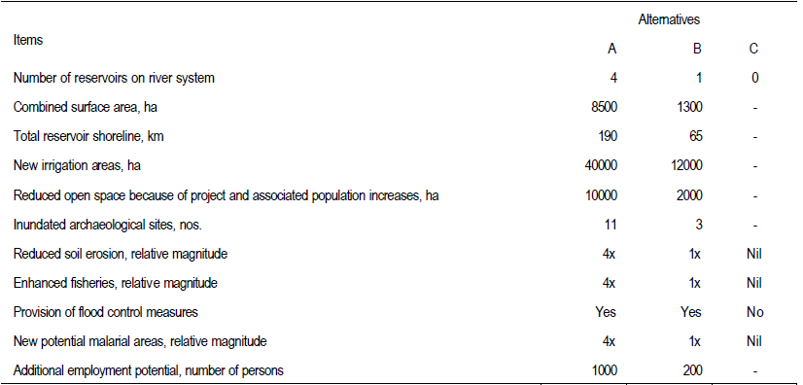
EIA METHODOLOGIES
Adhoc Technique -Adhoc procedures involve assembling a team of experts to identify impacts in their areas of expertise providing minimal guidelines for impact assessment and suggest broad areas of possible impacts rather than identifying specific parameters to be investigated.

Slide 15
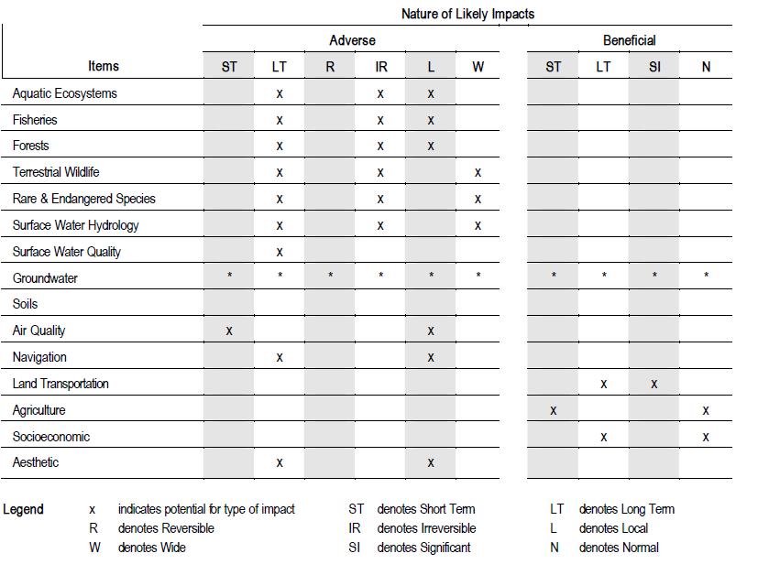
EIA METHODOLOGIES
Checklist Technique- Checklist present a specific list of environmental parameters to be investigated for possible impacts and do not require establishing direct cause-effect links to project activities.
Simple checklist developed for the Huasai-Thale Noi Road Project (source: National Environment Board, 1980).

Slide 16
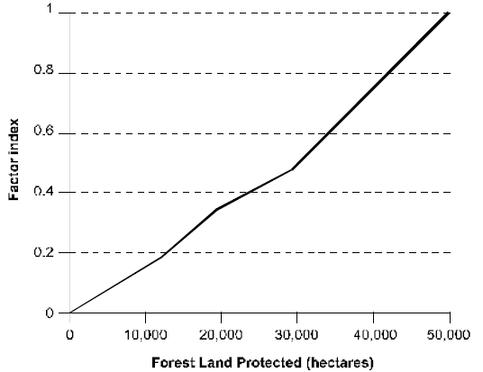
EIA METHODOLOGIES
Checklist Technique- Two alternative examples to illustrate scaling techniques(Source: National Environmental Board, 1980)
Factors | Factor Index | Alternative One |  | Alternative Two
 |  | Raw Data | Scaled | Raw Data | Scaled
Wildlife Habitat Preserved (ha.) |  | 5000 |  | 10000
Employment Increase (jobs) |  | 5000 |  | 3000
Wildlife Habitat Index | 1 |  | 0.5 |  | 1.0
Employment Increase Index | 1 |  | 1.0 |  | 0.6
Grand Index |  |  | 1.5 |  | 1.6

Slide 17
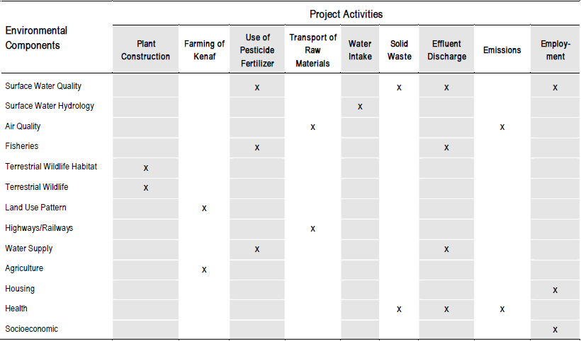
EIA METHODOLOGIES
Matrix Technique- Matrix methods are two dimensional checklists in which possible project activities are established along one axis with potentially impacted environmental characteristics or conditions along the other axis.( Source: Phoenix pulp mill EIA report, 2000)

Slide 18
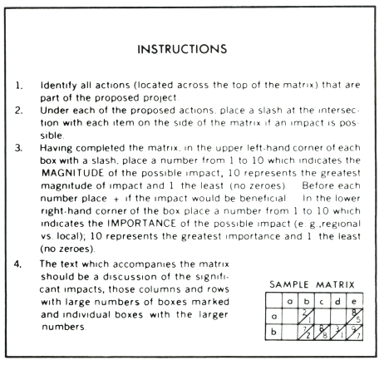
EIA METHODOLOGIES
Leopold Matrix- The Leopold Matrix lists the project actions arranged horizontally in the matrix and lists the Environmental Characteristics and Conditions Arranged Vertically in the matrix.( Source: Environmental Impact Assessment, Peter Wathern, Taylor and Francis Group ,1990)

Slide 19
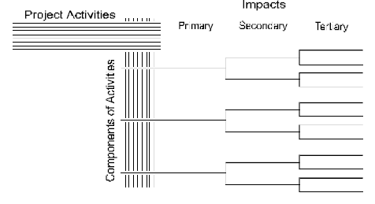

EIA METHODOLOGIES
Network Technique- Network approaches expand the concept of matrix by introducing a cause-condition-effect network that allows identification of cumulative or indirect effects not adequately explained through simple cause – effect sequences represented by matrices. (Source: Canter L. W., Environmental Impact Assessment, 1996)

Slide 20
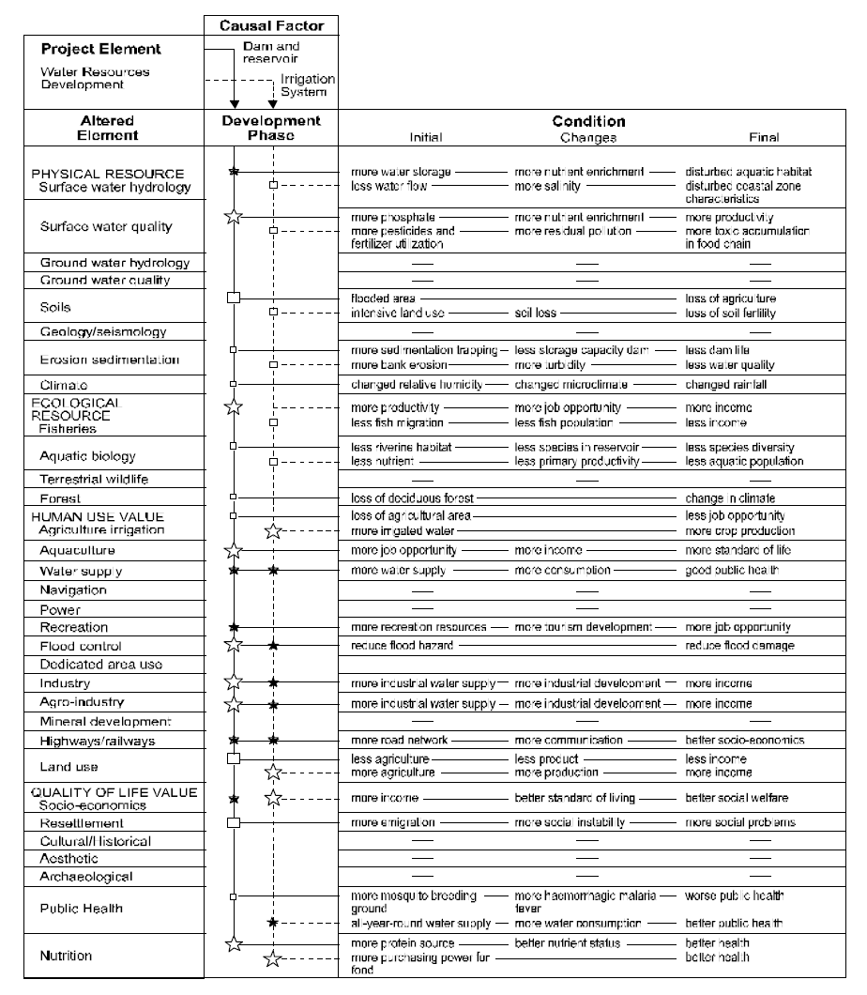
EIA METHODOLOGIES

Slide 21
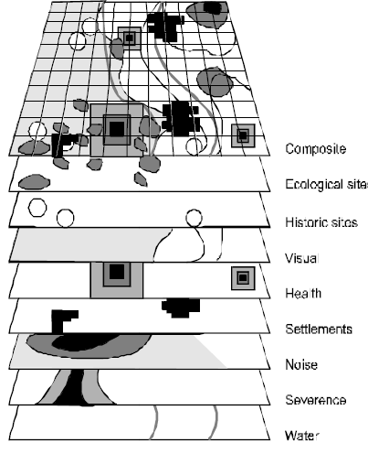
EIA METHODOLOGIES
Overlay Technique- Overlay techniques derived from planning and landscape architecture, rely on set of maps of environmental characteristics (physical, biological, socioeconomic , etc) of a project area. These maps are overlaid to produce a composite characteristic of the regional environment.(Source: Canter L. W., Environmental Impact Assessment, 1996)

Slide 22
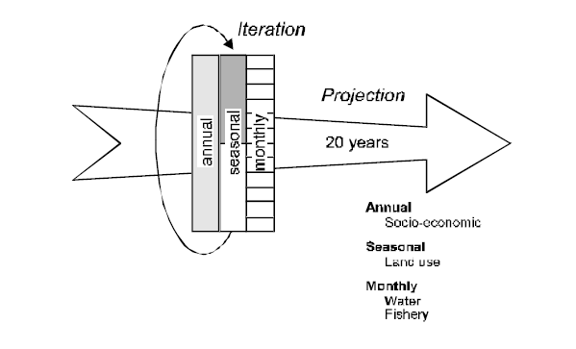
EIA METHODOLOGIES
Mathematical Model Techniques- System Analysts have evolved an approach to environmental impact assessment and management referred to as Adaptive Environment Assessment and Management (AEAM)which combines various simulation models to predict impacts. The method involves small interdisciplinary teams interaction through modelling workshops over relatively short periods to predict impacts and evaluate alternatives including management measues. (Source: Canter L. W., Environmental Impact Assessment, 1996)

Slide 23
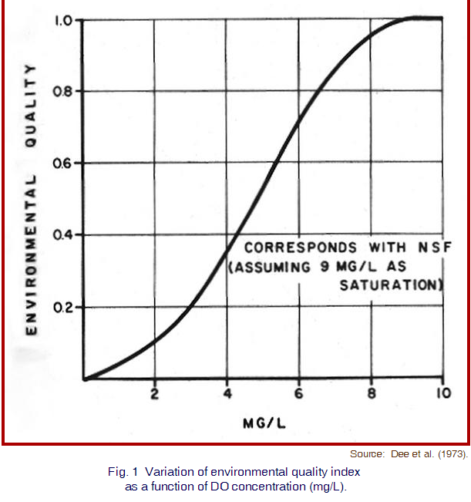
EIA METHODOLOGIES
Battele Environmental Evaluation System - In 1972 the Battele Environmental Evaluation System was developed for water resources projects. The evaluation system includes a checklist of environmental factors, organised into 4 categories, 17 components and 78 environmental parameters.
Major Features
The environmental impact of each alternative is expressed in commensurate units – Environmental Impact Units (EIU)
Transformation of parameter estimates (results of prediction) into an environmental quality (EQ) scale. (Source: Canter L. W., Environmental Impact Assessment, 1996)

Slide 24
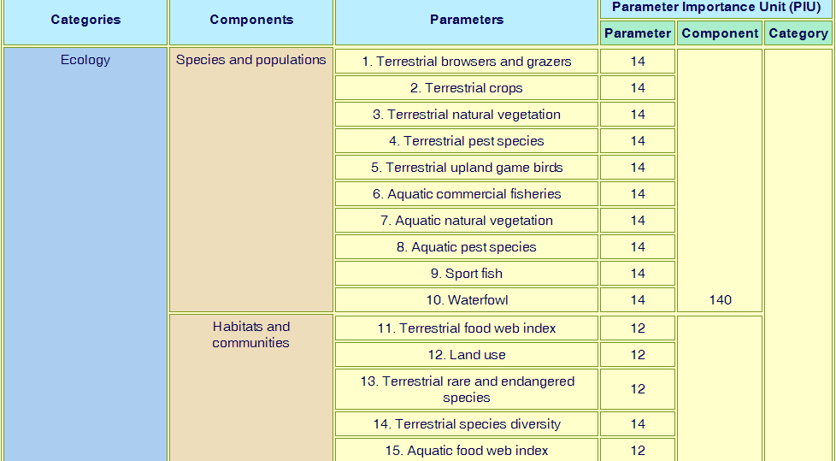


Slide 25
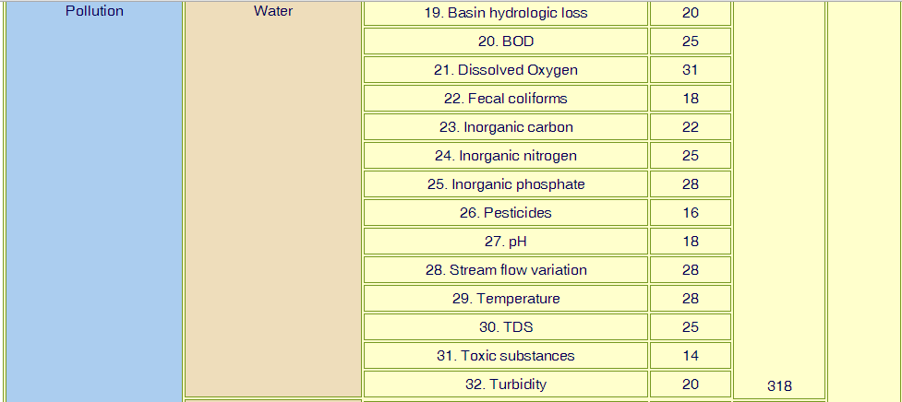



Slide 26
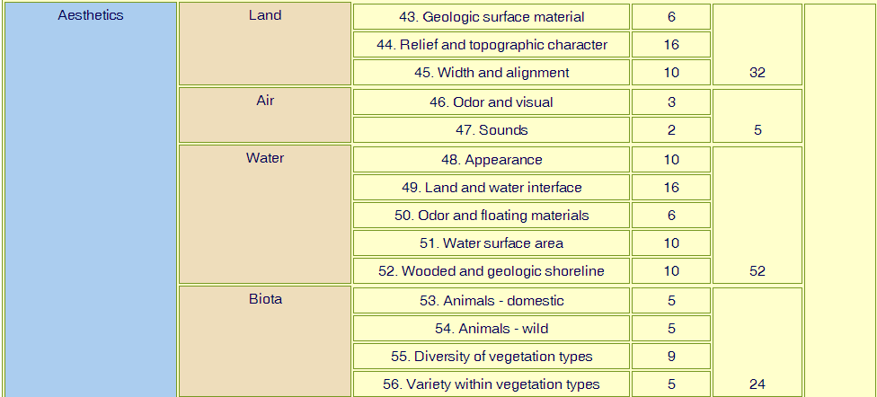


Slide 27
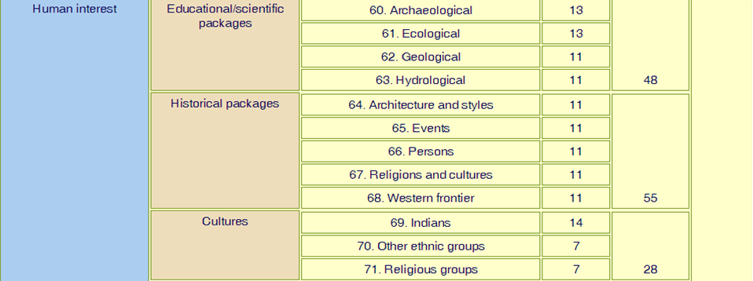
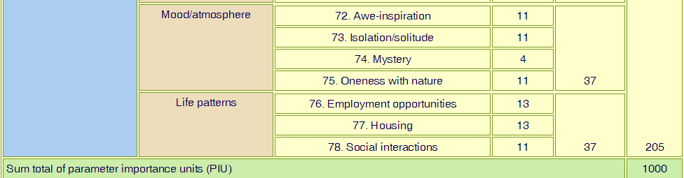

Slide 28
EIA METHODOLOGIES
Steps in BEES
Obtain parameter data without the project for each of the 78 environmental factors. Convert these parameter data into EQ values.
Multiply the scale values by the PIU for each of the individual parameters to develop composite score for the environment without the project
For each alternative predict the changes in the environmental parameters.
Determine the EQ scale for each parameter and ecah alternative utilizing predicted changes in the parameter values.
Multiply the EQ values for each alternative by each PIU , and aggregate the information for a total composite score.

Slide 29
Environmental Management Plan
Environmental Management Plan (EMP) is a concluding part of an EIA study which defines the scope for feasibility of a project depending on the adverse effects and techno-economical mitigation measures available to the project proponent
The document that ensures the implementation of mitigation prescriptions for environmental protection and sustainable development.
The salient features of EMP are as follows:
1. Management during construction phase.
2. Management during the post construction phase
3. Post Project Monitoring

Slide 30
LIMITATIONS OF EIA
Lack of political will and awareness of the need for environmental assessment
Insufficient Public Participation
Insufficient skilled manpower
Lack of sufficient data and information
Insufficient financial resources
Reports are too academic and lengthy

Slide 31
ADVANTAGES OF EIA
Though EIA is considered as a mandatory procedure for meeting the statutory requirements, it has many inbuilt advantages to the project proponent and to the society. Few of the advantages are:
  More environmental sustainable design.
Better compliance with statutory standards.
Savings in capital and operating costs.
Reduced time and costs for obtaining clearances.
Avoid later plant adaptations.
Reduced health cost.
Increased project acceptance.

Slide 32
BENEFITS TO INDUSTRY
Specifies the type of pollutants, quantity and quality of pollutants.
Enables to select appropriate technologies to combat pollution and to meet the statutory standards.
Enables to understand the viability of resource recovery in terms of salvaging from waste, recovery and recycle etc.,
Provides scope for cleaner production practices or alternate manufacturing methods.
A better Environmental Management Plan can be designed by understanding the impacts of project specific pollutants on the environment.

Slide 33
BENEFITS TO SOCIETY
Can understand the details of the project and its possible impacts on their environment.
It enables public to visualize possible accidents, also to overcome the same with effective remediation measures.
Can understand the economic development as against the natural resources depletion, and decide on project acceptance in their area well before project execution.

Slide 34
Topic outcome
EIA study is a valuable tool for identifying the potential impacts on Environment and to source appropriate technologies for mitigating the impacts to tolerable levels.
The effort put in by professionals in collecting as much technical details as possible about the project, the Baseline Data, Meteorological Data etc., will be of great use in defining a problem with better clarity for a realistic solution.

Slide 35
PRACTICAL Applications
EIA is a legal document and any attempt to provide wrong facts or down playing of relevant information is an offence.
Many project proponents consider investment for an EIA study as a burden and settle for economical rates and ultimately end up with inordinate delays for want of factual data by the authorities.
EIA Study is a protective weapon against vested interest groups and will defend scientifically and legally the right for existence of an Environment friendly project.

Slide 36
FAQs
Q. what is the purpose of EIA?
Q. What are steps in EIA?
Q. What are various methodologies to conduct EIA?

Slide 37
REFERENCES
Volume 2 of Handbook of Environmental Impact Assessment, Judith Petts, ISBN 0632047739, 9780632047734, Wiley 1999
Environmental Impact Assessment, Peter Wathern, Taylor and Francis Group ,1990
Lohani, B. and Kan, S., ‘Environmental evaluation for water resources in Thailand’, Wat. Resource. Develop. 1(3):185-195, 1983.
Canter L. W., Environmental Impact Assessment, Second Edition, McGraw-Hill Series in Water Resources and Environmental Engineering, New York, 1996

